Slide 1

FPGA Design for Embedded Systems
[Video Title]
[Instructor Name(s)]
[Department Name]
Hardware Description Languages for Logic Design
Copyright © 2019 University of Colorado

Slide 2
VHDL Evaluation
In this video, you will learn:
How to test code using an HDL simulator.
How to evaluate the correctness of your design using waveform analysis.
How to control the simulator to examine the code and its output.
Copyright © 2019 University of Colorado

Slide 3
VHDL Evaluation: 4-bit Adder
-- Entity
entity Add4 is port (
Data1,Data2 : in std_logic_vector(3 downto 0);
Cin : in std_logic;
Cout : out std_logic;
Sum : out std_logic_vector(3 downto 0) );
end entity Add4;
-- Architecture
architecture RTL of Add4 is
signal Out5bit : std_logic_vector(4 downto 0);
begin
Out5bit <= (‘0’ & Data1) + (‘0’ & Data2) + Cin;
Sum <= Out5bit(3 downto 0); -- 4 bits
Cout <= Out5bit(4); -- 5th bit
end architecture RTL;
Copyright © 2019 University of Colorado

Slide 4
Using ModelSim
Let’s Simulate !
We will use the provided Add4.vhd code in ModelSim.
Start ModelSim now and follow the steps as we simulate this code together.
Pause the Video when needed.
Copyright © 2019 University of Colorado

Slide 5
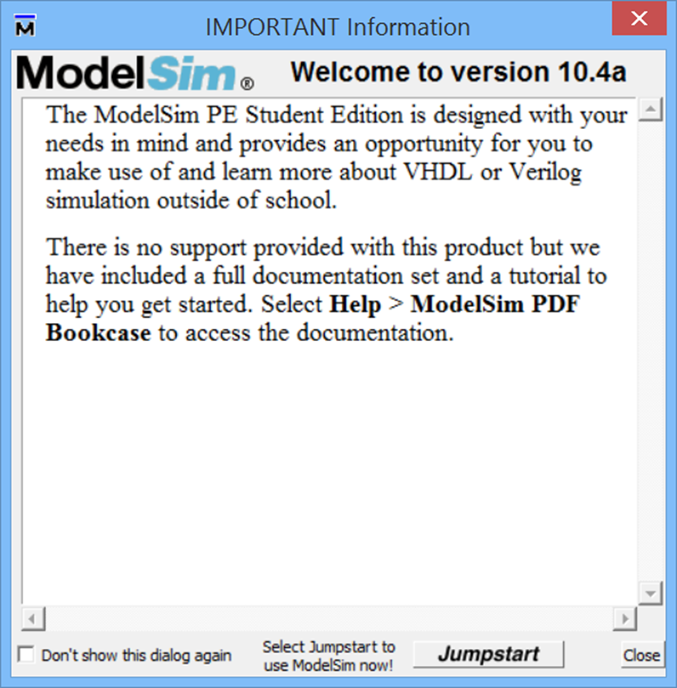
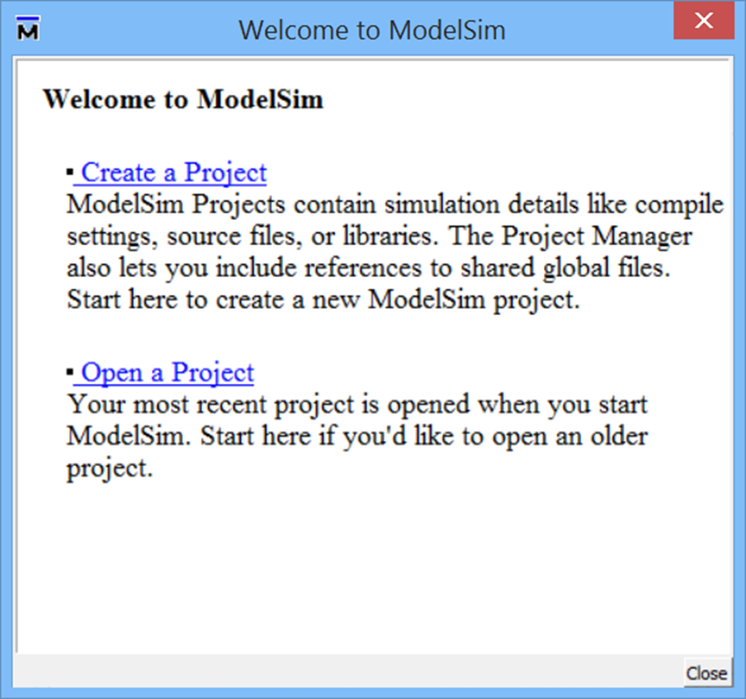

Using ModelSim
Copyright © 2019 University of Colorado

Slide 6
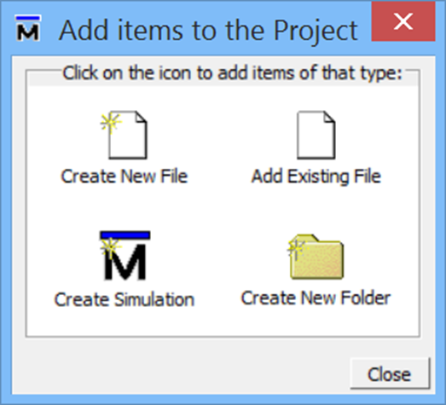

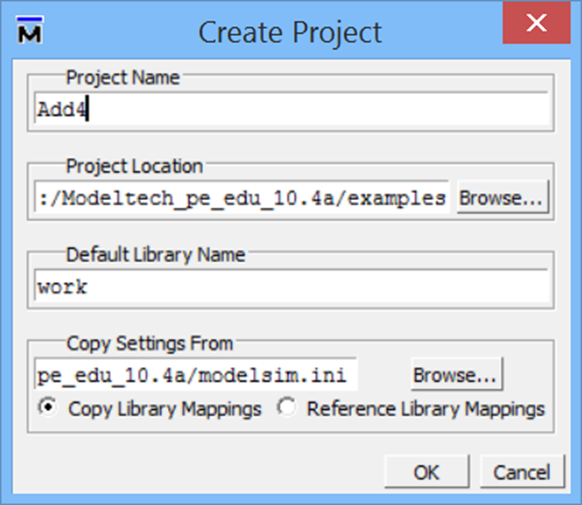
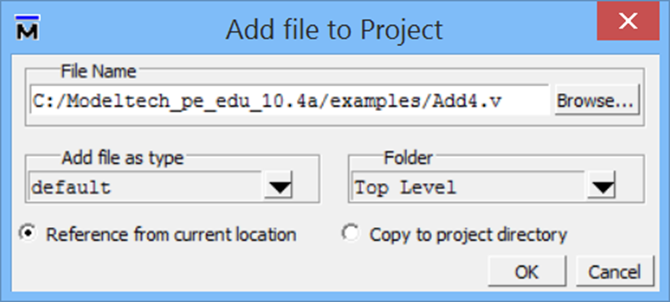

Using ModelSim
Place the provided file Add4.vhd into /examples/ directory
Copyright © 2019 University of Colorado

Slide 7
Using ModelSim
Copyright © 2019 University of Colorado

Slide 8
Using ModelSim
Copyright © 2019 University of Colorado

Slide 9
Using ModelSim
Copyright © 2019 University of Colorado

Slide 10
Using ModelSim
Copyright © 2019 University of Colorado

Slide 11
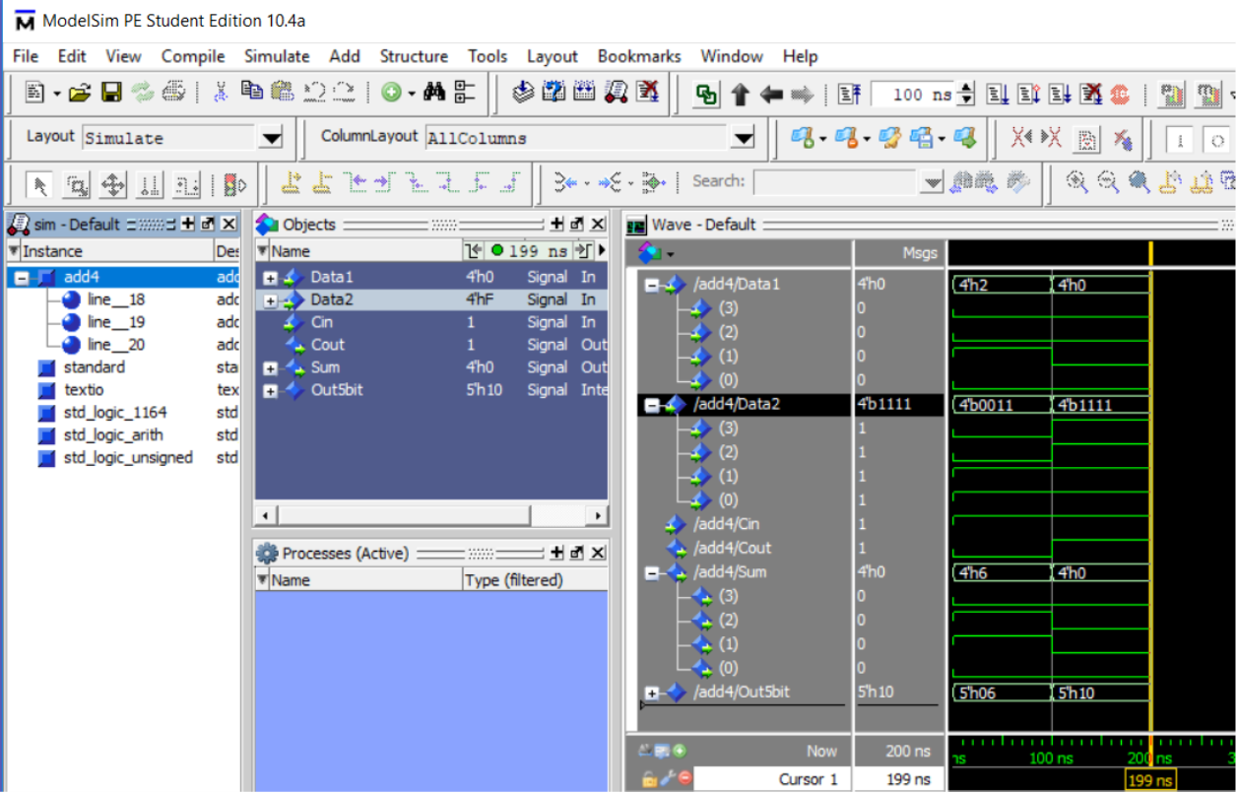
Using ModelSim
Copyright © 2019 University of Colorado

Slide 12
Using ModelSim
Copyright © 2019 University of Colorado

Slide 13
Summary – VHDL Evaluation
In this video, you have learned:
How to test the code using an HDL simulator, ModelSim.
How to evaluate the correctness of the design using waveform analysis.
How to control the Inputs and see the resulting Outputs, using different number combinations to get good test coverage.
Copyright © 2019 University of Colorado

